Slide 1

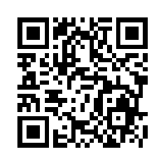
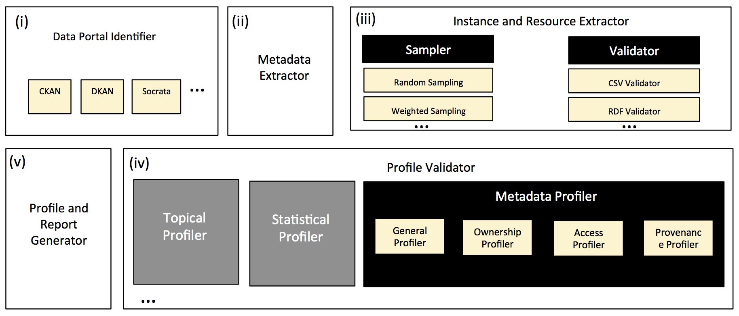
Roomba
Automatic Validation, Correction and Generation of Dataset Metadata - Enhancing Dataset Search and Spam Detection
Ahmad Assaf†, Raphaël Troncy† and Aline Senart‡
†EURECOM
Sophia Antipolis, France
firstname.lastname@eurecom.fr
‡ SAP Research, SAP Labs France SAS
Mougins, France
ahmad.assaf@sap.com
With Roomba, you can
Fetch all the information about datasets from a data portal
Fetch all the groups information from a data portal
Crawl datasets (a specific dataset, datasets in a specific group, datasets in the whole portal)
Execute aggregation report on a specific group or on the whole data portal
Profile a specific dataset, a whole group or the whole data portal
Metadata Information Types
General information: General information about the dataset, e.g. title, description and ID. This general information is manually filled by the dataset owner. In addition to that, tags and group information are required for classification and enhancing dataset discoverability. This information can be entered manually or inferred using modules plugged into the topical profiler.
Access information: Information about accessing and using the dataset. This includes the dataset URL, license information (i.e. license title and URL) and information about the dataset's resources. Each resource has also a set of attached metadata, e.g. resource name, URL, format, size.
Ownership information: Information about the ownership of the dataset, e.g. organization details, maintainer details, author. The existence of this information is important to identify the authority on which the generated report and the newly corrected profile will be sent to.
Provenance information: Temporal and historical information on the dataset and its resources, e.g. creation and update dates, version information. Most of this information can be automatically filled up and tracked.
Data Portal Inspection
Report Generation
URL inspection: Check the existence of certain URL patterns.
Meta tags inspection: For example, meta[content*="ckan] (all meta tags with the attribute content containing the string CKAN). This selector can identify CKAN portals whereas the meta[content*="Drupal"] can identify DKAN portals.
Document Object Model (DOM) inspection: Similar to the meta tags inspection, we check the existence of certain DOM elements or properties.
meta-field values report: Aggregate all the values of a certain key e.g. license_title will aggregate all the licenses titles
key:object meta-field values report: Aggregate all the values of a certain key with an aggregate of another field as its object. e.g. license_title:title will aggregate all the license titles used and also will aggregate all the titles for all the datasets using that license title
Check Empty field values report: Check all the datasets containing an empty value of the passed field key
All results are reproducible from our code base at https://github.com/ahmadassaf/opendata-checker

